Slide 1

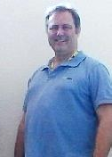
COM619 DevOps Smart Port Scenario
Dr Craig Gallen Eng.D MIEE, C.Eng
Craig Gallen
Email : craig.gallen@solent.ac.uk
Desk : JM506 ( Mondays / Tuesdays)
Mobile: +44 (0) 7789 938012
Craig

Slide 2
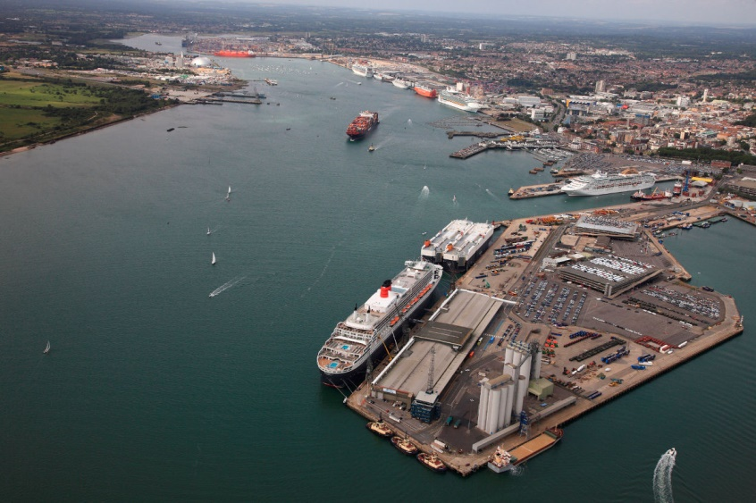
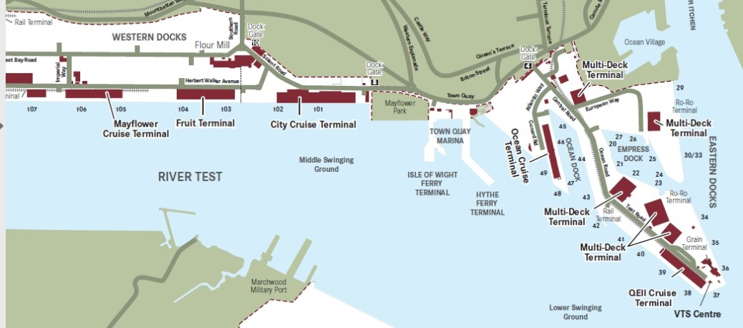
Southampton Smart Port
The UK’s number one cruise port, which welcomes 1.7m passengers
Each ship up to 6000 passenger and crew
Ship turn around 1-2 days
Smart Port
https://www.youtube.com/watch?v=V6nV12EfaYE Port of Southampton Video
https://www.youtube.com/watch?v=MpuG30EHvwU ABP's Port of Southampton on BBC's The One Show
What is a smart port https://www.porttechnology.org/news/what-is-a-smart-port/
A smart port integrates land based services to help automate ship arrivals and departures along side cargo and passenger movements.

Slide 3
Scenario
Southampton port is proposing to be upgraded to a 'Smart Port' in which many of the currently manual processes will be automated through Business to Business (B2B) communication. You have been asked to prototype a number of communicating systems which will dynamically represent the operation of the smart port.
These systems will each be owned and operated by the different companies participating in the operation of the port but will communicate through a common set of ReST API's. These API's should be designed to work with many parties i.e multiple ports and multiple shipping companies
Your prototype should demonstrate instances of these systems communicating and show that the API's you propose to use could form the basis of a standard for an electronic market place surrounding smart ports.
The prototype system will be constrained to look at four communicating systems owned by
Shipping line(s)
Port owners
Harbour Master (pilots)
Port services (Stevedores)

Slide 4
Systems Owners (partys)
Systems
Shipping line(s) system
ships (ship inventory)
shipping routes / schedules
bookings of port services
Port services (Stevedores) system
catalogue of ship services (waste, water, fuel, cargo, food etc)
Booking schedule
Harbour Master (pilots) system
ship locations
bookings for pilotage
destination berths
tides
Port owners (ABP) system
catalogue of berths / locations
booking schedule of berths
cloud hosted services
Shipping line system
Port Services system
Harbour Master system
Port Owners system
common services
banking
tide forecast
identity

Slide 5
Conceptual Shipping Line Service
separation of system into collaborating services orchestrated by business logic
ReST Services
UI
Business Services
Book Ship
Ship to port
Ship departure
Bill payment
ReST Client
common model of nouns (ships, berths etc) and verbs (crud, book ship, depart ship etc)
ReST Services
External Data Stores /Services
Internal
Data Stores /Services
Tide service
Berth Catalogue
Ship Inventory
Ship Bookings
Berth Bookings
Invoices

Slide 6
Machine-2-Machine using ReST
ReST interfaces are often used for machine to machine communications at the level of the business logic
ReST Representational state transfer
https://en.wikipedia.org/wiki/Representational_state_transfer
Browser/App
Browser/App
view
view
Java Script
Interpreter
Java Script
Interpreter
Server
Server
Web Server
Web Server
Page Generation
ReST
Page Generation
ReST
Programming API
Programming API
controller
controller
Business Logic
ReST
Client
Business Logic
SQL
HTTP Response
Content: json/XML
SQL
model
HTTP Request
GET, POST, DELETE, PUT etc
model
(Persistence)
Database
(Persistence)
Database

Slide 7
ReST Service Test Harness
Admin
Rest API
Admin
Rest API
Automated Test Cases
Rest Client
Shipping line system
Rest Client
Dummy Mock Services
Rest API
Rest API
Deployment
Build and test
Build a test harness for each service to prove the business logic before full integration
Github actions cause build on each commit
maven build and test
maven packaging as docker container
containers released for testing in docker compos
Deployment Orchestration
docker compose or Kubernetes
Components as docker containers with external configuration ( environment variables)

Slide 8
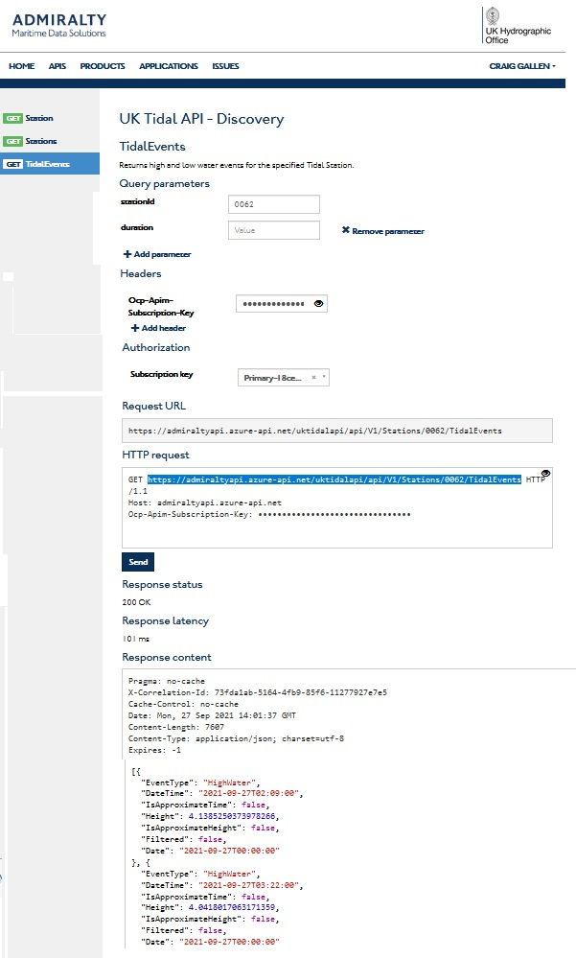
API specification
Tidal API
API written as openAPI specification (Swagger)
Web site provides test code to run api

Slide 9
Government Tidal API
https://www.admiralty.co.uk/digital-services/data-solutions/uk-tidal-api
Sign up with basic subscription (7 days tidal info)
get stations
https://admiraltyapi.azure-api.net/uktidalapi/api/V1/Stations
{
"type": "FeatureCollection",
"features": [{
"type": "Feature",
"geometry": {
"type": "Point",
"coordinates": [-1.4, 50.883333]
},
"properties": {
"Id": "0062",
"Name": "SOUTHAMPTON",
"Country": "England",
"ContinuousHeightsAvailable": true,
"Footnote": null
}
}]
}
get tidal events
https://admiraltyapi.azure-api.net/uktidalapi/api/V1/Stations/0062/TidalEvents
[{
"EventType": "HighWater",
"DateTime": "2021-09-27T02:09:00",
"IsApproximateTime": false,
"Height": 4.1385250373978266,
"IsApproximateHeight": false,
"Filtered": false,
"Date": "2021-09-27T00:00:00"
}, {
"EventType": "HighWater",
"DateTime": "2021-09-27T03:22:00",
"IsApproximateTime": false,
"Height": 4.0418017063171359,
"IsApproximateHeight": false,
"Filtered": false,
"Date": "2021-09-27T00:00:00"
}, {
"EventType": "LowWater",
"DateTime": "2021-09-27T07:35:00",
"IsApproximateTime": false,
"Height": 1.5580592461708462,
"IsApproximateHeight": false,
"Filtered": false,
"Date": "2021-09-27T00:00:00"
}]

Slide 10
Sprint 1 Development planning
Technology Neutral Design
DFD for your system
Epic / Story / Feature list for system (use cases)
Data model for your system
Sequence diagrams / state diagrams for each use case
Github project plan allocating stories to team
Test plan – automated test harness
Identify services you depend upon and negotiate information model
Technology Investigation
ReST and UI – simple CRUD operations
SpringData / SpringMVC / SpringReST
Swagger / OpenAPI / TMForum Open Digital Architecture
Maven clean install
Github actions
package and deploy - Docker / Docker compose (Kubernetes?)

Slide 11
Sprint 2 – First prototype
Technology neutral design
Identify services you depend upon and negotiate information model with other teams
Overall project plan for build test and merge
First prototype
Basic crud operations on data stores
User identity management – Admin / User
Schedule 'appointments'
Build and deploy
docker / docker compose configurations and deployment of each

Slide 12
Sprint 3 – Integrated system
Technology neutral design
Overall project plan for build test and merge
Test plan for end to end testing – and test harness
Inter system Communication prototype
End to end booking of ship into port and required services
Build and deploy
docker / docker compose configurations and deployment of each

Slide 13
Data Flow Diagrams
Data Stores
existing or planned repositories for data
can be any form of data store e.g. a book, a folder, a spreadsheet, a database a card holder or a whiteboard
Process
Distinct activities which are performed using the data.
Parties
organisations or individuals who are involved I processes. Note that parties never interact directly with the data stores.
D1
data store
Flow: process uses data
P1
Process
Parties are
involved
in process
External party
Internal party

Slide 14
Exercise: A DFD for Southampton Port
Associated British ports ABB, is the operator of the port of Southampton. They maintain berthing facilities for over 50 ships at a time. They have many berths of various sizes.
Long before arrival, the ship's itinerary is planned with associated port bookings.
Shortly before arrival each ship’s captain orders services from the port including access to the port and water and waste services. On arrival the ships are met, tracked and guided up the channel by the port pilots and their location can be viewed on the ship location system. Ships at berth are also listed on the ABP portal.
Ships must schedule arrival and departure in line with high tide and when a berth has been vacated by a previous occupant.
Key players
Ship owners schedule arrival of ships in ports
Ship captains confirm final approach and work with port and pilots on arrival
Suppliers (stevedores) wishing to provision a ship in port can find their location and berth from the ABP portal.
Stevedores provision cargo and services for ships in port
Port pilots guide ships around the Solent and into port
Construct a data flow diagram for the principal data flowing through the port.

Slide 15
The key information
Key Information concerning each ship is provided on the following sites.
http://www.southamptonvts.co.uk/Port_Information/Berths_and_Facilities/
berth id, Advertised Depth (m) , Length
http://www.southamptonvts.co.uk/Live_Information/Shipping_Movements_and_Cruise_Ship_Schedule/Vessels_Alongside/
Ship Name, Lloyds No, Type, Flag, Actual Arrival Time, Berth, Origin, Side To,Draft ,LOA, DWT, Agent
Port Southampton (locode: GBSOU) (https://www.vesselfinder.com/?p=1723) based upon AIS information
Port tarrifs Associated British ports Port tarrifs http://www.southamptonvts.co.uk/Port_Information/Commercial/Southampton_Tariff/
http://www.southamptonvts.co.uk/Live_Information/Tides_and_Weather/High_and_Low_Tide_Times/

